Slide 1
Solution& Implementation
A. Show declaration of the target variable
B. Show value of last running (execution time)of the target variable

Slide 2
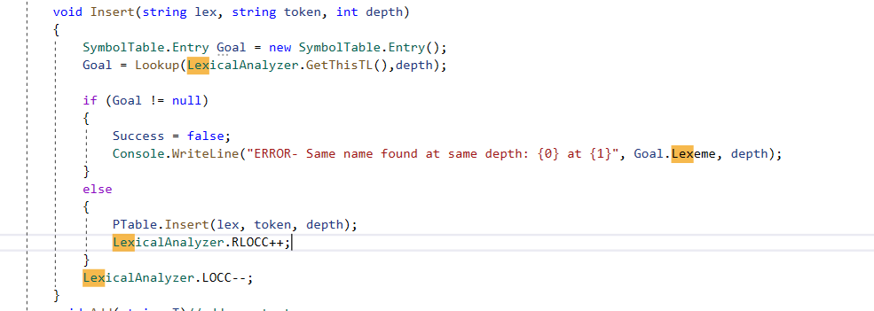
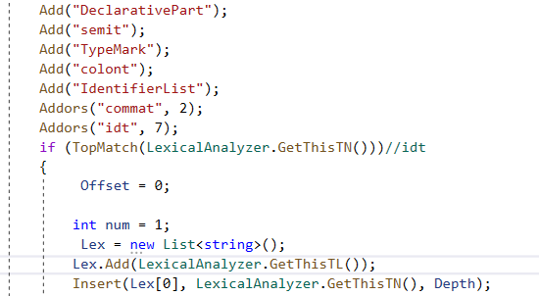
Show the location of declaration of a target variable
1. While compiler is parsing, though ENF it determines if id token that LexicalAnalyer gave is a declaration or not, and determine if declaration repeats or not

Slide 3
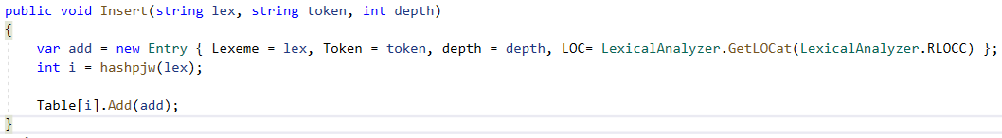
Show the location of declaration of a target variable(2)
2. When the determined new id token is first time declared, it insert it into SymbolTable
Which is where we can find the data we need (Lexeme(name), depth(Static Block depth), type of variable. but this is not enough yet.

Slide 4

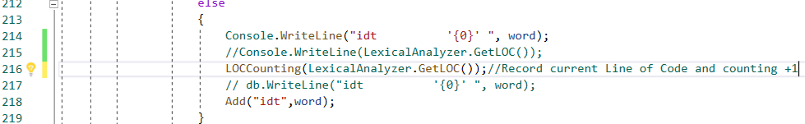
Show the location of declaration of a target variable(3)
3. We need a line of code to locate the declaration in detail, so we added an array that record the Line of Code in LexicalAnalyzer
And now we are able to locate the line of code, for id token while parsing is processing.

Slide 5
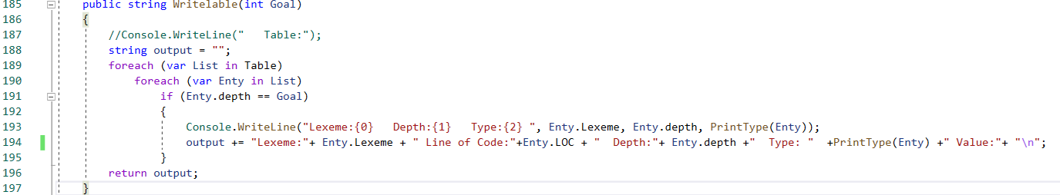
Show the location of declaration of a target variable(4)
4. Now we have found the data we need to locate the declaration of one target variable, we store the data into a txt file
Because editor is not running in compiler.

Slide 6
Demo: Show the location of declaration of a target variable

Slide 7
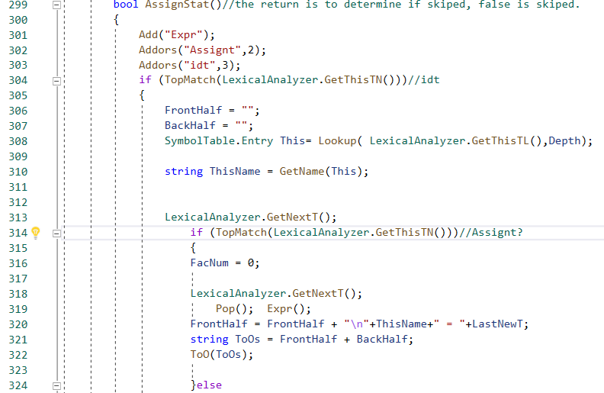
Show the value of the target variable in the last execution reference time
1. Locate the assign statement

Slide 8
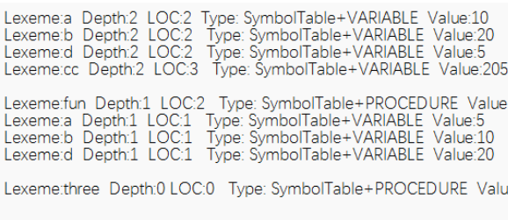
Show the value of the target variable in the last execution reference time(2)
2. Modify grammar, add a line of code after every assign statement, which will:
Use Lexme and Depth to find related variable in the file that’s been made while storing Line of Code, update the Value. By this way , we are able to save information from execution reference time.

